Slide 1
Federal Legislative Update
Matthew McKenna
Director, Great Lakes Washington Program
March 20, 2017

Slide 2
2017 Legislative Outlook
The Administration’s FY18 Budget Blueprint
Congress and the FY17 and FY18 Appropriations Bills
The Fight to Fund GLRI
The Vessel Incidental Discharge Act (VIDA)
Great Lakes Specific Legislation
Congressional Great Lakes Task Force Activities
Other Major Federal Legislative Initiatives

Slide 3
The Administration’s FY18 Budget Blueprint
Eliminates all funding for the GLRI.
Reduces the EPA’s budget by 31 percent and cuts its workforce 20 percent which would eliminate roughly 3,200 jobs at EPA. The Blueprint also reduces support for EPA programs looking to combat climate change and reduces grants to states and local governments by $482 million.
Reduces the Department of Commerce’s budget by 16 percent and calls for the elimination of $250 million in NOAA grants and programs including the Sea Grant program.
Reduces the USDA’s budget by 21 percent including decreasing funding for lower priority programs in the National Forest System and eliminating programs like the USDA’s Rural Development Water and Wastewater Loan Program.
Reduces the Department of Transportation’s budget by 13 percent by eliminating programs such as the TIGER discretionary grant program.
Notes:
Last week President Trump released his “skinny” budget, that recommended a wide range of deep cuts and the elimination of many programs in order to balance a recommended $54 billion increase in defense spending.
This slide has examples of some of the cuts that would most directly impact the Great Lakes region.
I’m going to focus on the GLRI and EPA
GLRI would be zeroed out in the FY2018 budget
EPA would face very dramatic cuts. Overall the budget would be slashed by 31%, with a reduction of the EPA’s workforce by 20% and a reduction of grants to states and local governments by $482 million to a total of $597 million.
Additionally, two important reductions that are not included on this slide are:
The USACE’s budget would be reduced by $1 billion to $5 billion overall
The budget would zero out discretionary funding for FEMA’s National Flood Insurance Program’s flood hazard mapping program.

Slide 4
Congress and the FY17 and FY18 Appropriations Process
Congress has until April 28 to pass the remaining 11 appropriations bills keeping the government funded through September 30th.
The House passed the FY 2017 Defense Appropriations Act earlier this month that was pre-negotiated with the Senate. This could serve as a potential vehicle to move an omnibus bill.
President Trump is looking for an additional $18 billion in cuts in FY17, but Congressional appropriators could ignore this.
Congress could also consider a supplemental bill for FY17 that would provide an additional $33 billion in spending for defense and for the construction of a wall on the southern border,
House Appropriations Committee Chairman Rodney Frelinghuysen (NJ) and Senate Appropriations Committee Chairman Thad Cochran (MS) are beginning hearings on the FY 2018 budget this week.
Notes:
Congress has about 20 work days to finish off the remaining FY17 11 appropriations bill by April 28, which is when the current CR is set to expire.
The House just passed the FY17 Defense Appropriations bill, which has already been pre-negotiated with the Senate.
While appropriators haven’t announced how they plan to move ahead on FY17, they could use the Defense bill as a vehicle for an omnibus.
Congress could also consider a supplemental bill to provide an additional $33 billion for defense and the construction of a border wall.
The House and Senate Appropriations Committees have already been holding “Member hearings” to register input from Members of Congress on the FY18 bills and have begun pressing forward with hearings on the President’s budget request this week.
The President is expected to send Congress a more detailed budget in May.

Slide 5
Fight to Fund the GLRI
At the end of 2016 Congress passed a $300 million a year, five year authorization of the GLRI in the WIIN Act / WRDA 2016.
Earlier in the fall, Rep. David Joyce (OH) had offered his GLRI bill as an amendment to the House’s original version of WRDA. It passed by a vote of 407-18. It should be noted that one of the “No” votes was former-Congressman and current OMB Director Mick Mulvaney.
The Senate Great Lakes Task Force, led by Co-Chairs Senators Debbie Stabenow (MI) and Rob Portman (OH), sent a bipartisan letter to EPA Administrator Pruitt expressing their deep concerns with drastic cuts to the GLRI (3/10). Additional Senators signing onto the letter included: Senators Klobuchar (MN), Durbin (IL), Brown (OH), Baldwin (WI), Franken (MN), Donnelly (IN), Gillibrand (NY), Casey (PA), Peters (MI), and Duckworth (IL).
Additionally, letters calling on Congressional Appropriators to fund GLRI at $300 million in FY18 are also being worked on.
Notes:
One of the largest issues facing the Great Lakes at the federal level is the proposed cuts to GLRI.
Many Great Lakes lawmakers have released statements in opposition to the cuts to the GLRI.
And the GLRI has received large bipartisan support in the past. Last fall during the WRDA debate, the GLRI was passed by an overwhelming vote of 407-18. I should note though that one of the “no” votes was cast by Mick Mulvaney, who is the new OMB Director.
Senate Great Lakes Task Force, led by Co-Chairs Sen. Stabenow and Sen. Portman, sent a letter to EPA about their concerns with potential cuts.
Letter is also being circulated to Members to send to the Appropriations Committee in support of $300 million for GLRI in FY18.

Slide 6
The Vessel Incidental Discharge Act (VIDA)
VIDA Reintroduced in 115th Congress
VIDA requires the U.S. Coast Guard to develop national ballast water standards and removes the Clean Water Act’s jurisdiction over ballast water management systems.
Senator Roger Wicker introduced S. 168 on 1/17/17 and Congressman Duncan Hunter Jr. introduced H.R. 1154 on 2/16/17.
Senate Commerce Committee Approves VIDA
On 1/24/17, the Senate Committee on Commerce, Science, and Transportation approved VIDA by voice vote without amendments.
While the bill was reported favorably by the Committee by voice vote, a handful of Democrats on the Committee asked to be recorded in opposition to the legislation including Great Lakes Senators Tammy Baldwin (WI) and Gary Peters (MI) citing concerns with invasive species.
Notes:
The Vessel Incidental Discharge Act (VIDA), which would make the US Coast Guard the sole regulator of ballast water discharge, has been reintroduced in both the Senate and House.
The Senate Commerce Committee reported the bill out of Committee by a voice vote, several Democratic lawmakers, including Sen. Baldwin and Sen. Peters asked to be on the recorded in opposition to the legislation.
Last Congress, VIDA was tacked on to the House’s National Defense Authorization (NDAA). There was a big push to include it in the final NDAA conference report, but was pulled at the last minute to help move the NDAA on for final passage.
There will likely be more attempts to hitch VIDA onto legislation that begins to move.

Slide 7
Great Lakes Specific Federal Legislation Introduced in the 115th Congress
Preserve Our Lakes and Keep Our Environment Safe Act (H.R. 458)
Introduced by Reps. Dave Trott (MI) and Debbie Dingell (MI) on 1/11/17.
Directs federal regulators to decommission the controversial Enbridge pipeline under the Straits of Mackinac if a 12-month Department of Transportation study finds it poses a significant risk to the Great Lakes.
Ban Aquaculture in the Great Lakes Act (H.R. 961)
Introduced by Rep. Dan Kildee (MI) on 2/7/17.
Bans aquaculture facilities in the Great Lakes.
Congressional Resolution Calling on the Canadian Government to not permanently store nuclear waste in the Great Lakes Basin (H. Res. 197 and S. Res. 88)
Introduced by Sens. Debbie Stabenow and Gary Peters and Rep. Dan Kildee last week.
Expresses Congressional opposition to construction of a nuclear waste repository less than a mile from Lake Huron in Ontario.

Slide 8
Great Lakes Specific Federal Legislation (continued)
The Great Lakes Fishery Research Authorization Act of 2017
Introduced by Reps. Mike Quigley (IL) and Fred Upton (MI) on 3/16/17.
Formally authorizes the US Geological Survey (USGS) Great Lakes Science Center (GLSC) to ensure critical scientific support for the commercial Great Lakes fishery industry.

Slide 9
Congressional Great Lakes Task Force
Congressional Great Lakes Task Force Leadership (italicized indicates new to the leadership this Congress):
Senate Co-Chairs – Senators Debbie Stabenow (MI) and Rob Portman (OH) Senate Vice-Chair – Senators Amy Klobuchar (MN) House Co-Chairs – Representatives Louise Slaughter (NY), Sean Duffy (WI), Marcy Kaptur (OH), and Bill Huizenga (MI)
Recent Activities by Great Lakes Task Force and Great Lakes Congressional Delegation
2/8 – Bipartisan House letter to President Trump urging him to fund the GLRI, respond to the threats that invasive species pose to the Great Lakes, and fund key infrastructure initiatives like the modernization of the Soo Locks.
2/22 – Bicameral and bipartisan letter to the U.S. Army Corps of Engineers stressing the importance of completing the study at the Soo Locks in an accurate and timely manner.
3/3 – Bipartisan House letter to President Trump calling on him to urge the U.S. Army Corps of Engineers to immediately release the first draft of the Brandon Road study.
3/10 – Bipartisan Senate letter to EPA Administrator Pruitt about concerns of dramatic cuts to the GLRI.

Slide 10
Other Big Ticket Legislative Proposals
Major infrastructure legislation
During the 2016 Presidential election, President Trump pledged new major investments in infrastructure.
The White House has yet to release any significant details about an infrastructure proposal.
Senate Democrats unveiled a $1 trillion plan to revamp the nation’s airports, bridges, roads and seaports.
2018 Farm Bill
The House and Senate Agriculture Committees have already began holding legislative hearings on an upcoming farm bill.
The conservation title of the bill will likely look to build upon the NRCS’s Regional Conservation Partnership Program (RCPP), the voluntary program between conservation partners and agricultural producers to work together to harness innovation and expand the conservation.
Trade Agreements
The renegotiation of NAFTA:
Revisit electric commerce;
Labor standards; and
Environmental standards.
Water Resources Development Act (WRDA)
Leadership in Congress has said that it’s their goal to pass a WRDA every two years.
Major U.S. Army Corps projects like the modernization of the Soo Locks could be a target for a WRDA bill in 2018.
Energy Reform Package
Last year, House and Senate negotiators came close to striking a deal on energy efficiency reforms. These efforts could resume this Congress.
Tax Reform

Slide 11
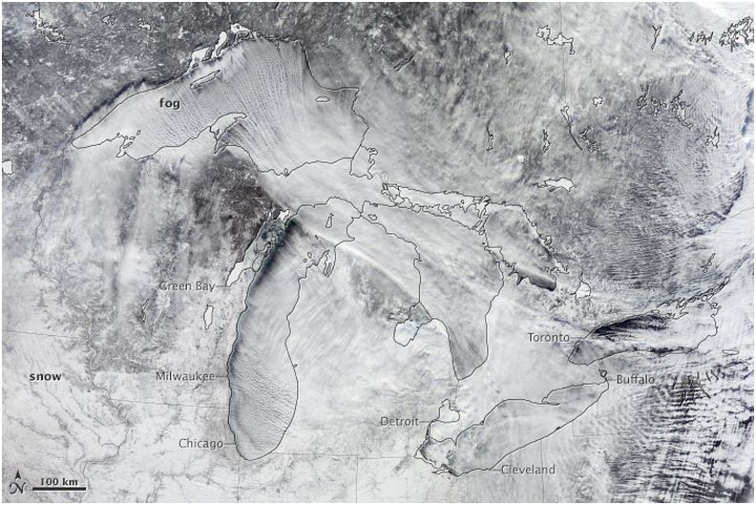
Questions
NASA

