Slide 1
Asian Carp Regional Coordinating Committee
2017 Asian Carp
Action Plan
Briefing
January 11, 2017
Notes:
Kevin

Slide 2
Welcome and Introductions
Matthew McKenna, Director, Northeast Midwest Institute
Mike Weimer, Co-Chair ACRCC, USFWS
Bill Bolen, Co-Chair ACRCC, USEPA

Slide 3
Asian Carp Regional Coordinating Committee 2017 Action Plan
Mike Weimer
Co-chair of the ACRCC,
U.S. Fish and Wildlife Service

Slide 4
2017 Action Plan
Asian Carp Regional Coordinating Committee
A binational partnership of 27 Federal, State, an Provincial partners working to protect the Great Lakes basin from the Asian Carp threat.

Slide 5
2017 Action Plan
Purpose:
“To prevent the introduction, establishment, and spread of Bighead, Black, Grass, and Silver Carp populations in the Great Lakes”

Slide 6
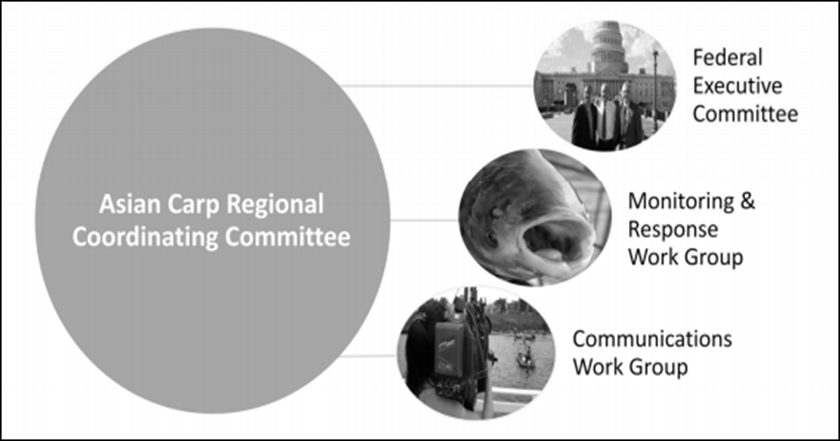
ACRCC Structure

Slide 7
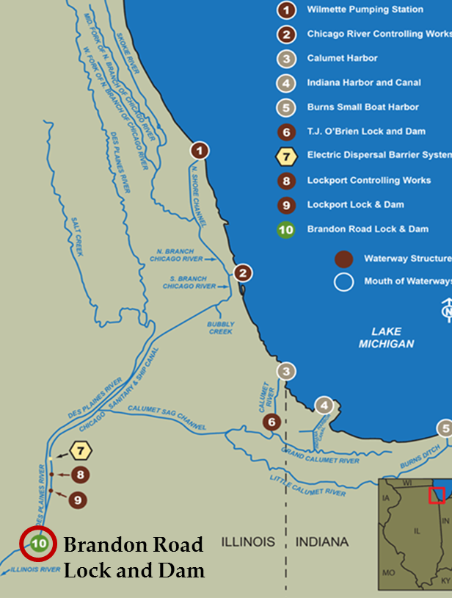
Prevention Focused at Potential Basin Entry Pathways
Primary
Chicago Area Waterway System
Primary Pathway – Chicago Area Waterway System
18 Intermittent Secondary Pathways
Secondary
Notes:
Corps of Engineers-led analysis of possible hydrologic connections between the Great Lakes and Mississippi River basins and AIS control options

Slide 8
2017 Action Plan
2017 Highlights:
Builds on 2016 Action Plan
Includes over 60 collaborative agency projects
Supports the ACRCC 2017 Monitoring and Response activities
Early detection, rapid response and contingency planning
Includes new out-year planning goals and objectives
Supports long-term agency coordination and strategic planning

Slide 9
2017 Action Plan
2017 Key Initiatives:
Construction of a new electric barrier
Intermittent Pathways:
Closure actions at Ohio-Erie Canal and Little Killbuck Creek Pathways
Continuation of Brandon Road efforts
Development of new detection and removal techniques and gears

Slide 10
2017 Action Plan
2017 Key Initiatives
Targeted removal of small Asian carp in key locations in the Upper Illinois Waterway
Refinement of Contingency Response Plan (per new data and available tools)
Development/field-testing of potential new control technologies (e.g. CO2, complex sound)
Intensive monitoring for Asian carp (all life stages) upstream and downstream of Electrical Dispersal Barrier
Action to address emerging threats from Black and Grass Carp

Slide 11
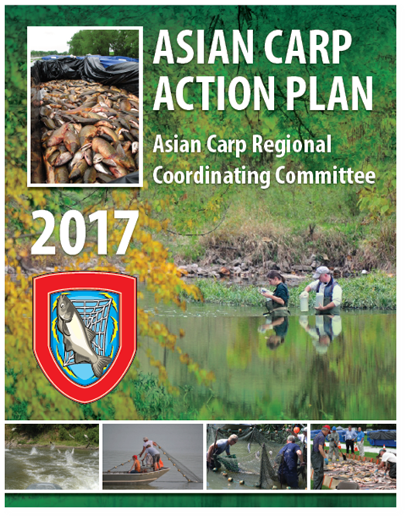
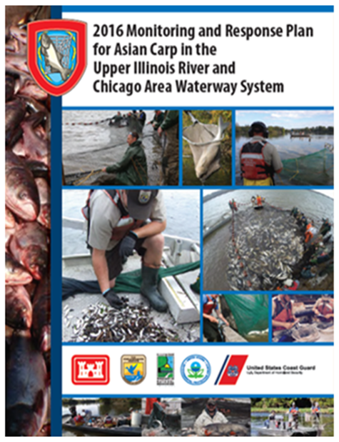
Monitoring and Response Plan
Monitoring and Response Plan >> “Tactical” battle plan, puts the Action Plan into effect (What, When and Where)
Includes Contingency Response Plans (added in 2016)
ACRCC response if Asian carp are detected in upstream locations closer to Great Lakes; focus on 5 navigation pools below the EDB
Includes
Contingency Response Plans

Slide 12
Bill Bolen Co-chair of the ACRCC and USEPA Senior Advisor
2017
Funding Summary

Slide 13
GLRI Asian Carp 2010 - 2017
Agency | FY 2010 | FY 2011 | FY 2012 | FY 2013 | FY 2014 | FY 2015 | FY 2016 | FY 2017
USGS | $4,643,000 | $4,673,934 | $2,055,100 | $1,625,000 | $3,523,232 | $3,935,500 | $5,240,000 | $4,392,000
USACE | $14,040,000 | $7,481,680 | $5,868,000 | $3,600,000 | $1,830,740 | $3,916,500 | $2,594,000 | $3,862,500
USEPA | $400,000 | $400,529 | $373,583 | $340,000 | $0 | $0 | $1,713,000 | $465,910
USCG | $500,000 | $380,000 | $360,000 | $0 | $0 | $0 | $209,000 | $400,000
USFWS | $1,410,000 | $5,080,444 | $3,610,000 | $3,580,000 | $4,918,028 | $4,024,000 | $3,260,000 | $2,745,000
NOAA | $0 | $1,166,169 | $785,617 | $292,800 | $0 | $0 | $0 | $159,590
States | $4,000,000 | $5,718,000 | $6,337,417 | $5,373,000 | $5,728,000 | $4,124,000 | $4,522,000 | $4,900,000
NPS | $0 | $0 | $0 | $0 | $0 | $0 | $0 | $75,000
USDA-NRCS | $0 | $0 | $0 | $1,200,000 | $0 | $0 | $0 | $0
Total cost | $24,993,000 | $24,900,756 | $19,389,717 | $16,010,800 | $16,000,000 | $16,000,000 | $17,538,000 | $17,000,000

Slide 14
Asian Carp Agency Funding 2010 - 2017
Agency | FY 2010 | FY 2011 | FY 2012 | FY 2013 | FY 2014 | FY 2015 | FY 2016 | FY 2017
USGS | $692,000 | $552,000 | $3,052,000 | $5,617,000 | $3,264,942 | $5,260,229 | $5,228,000 | $5,228,000
USACE | $25,095,000 | $13,372,000 | $27,065,000 | $27,500,000 | $39,000,000 | $50,200,000 | $29,000,000 | $14,600,000
USEPA | $0 | $0 | $0 | $0 | $0 | $0 | $0 | $0
USCG Guard | $0 | $0 | $98,000 | $0 | $0 | $5,600 | $7,600 | $77,000
USFWS | $320,000 | $320,000 | $2,000,000 | $2,900,000 | $2,790,094 | $2,797,088 | $5,300,000 | $5,300,000
NOAA | $497,846 | $497,122 | $60,000 | $684,680 | $0 | $0 | $152,128 | $179,905
States | $0 | $0 | --- | $0 | $0 | $0 | $150,000 | $0
NPS | $0 | $0 | $0 | $0 | $0 | $0 | $0 | $0
USDA-NRCS | $0 | $0 | --- | $0 | $0 | $0 | $0 | $0
Total cost | $26,604,846 | $14,741,122 | $32,275,000 | $36,701,680 | $45,055,036 | $58,262,917 | $39,837,728 | $25,384,905

Slide 15
Monitoring Update and 2017 USFWS Actions
Charles Wooley
Deputy Regional Director for the Midwest Region, USFWS

Slide 16
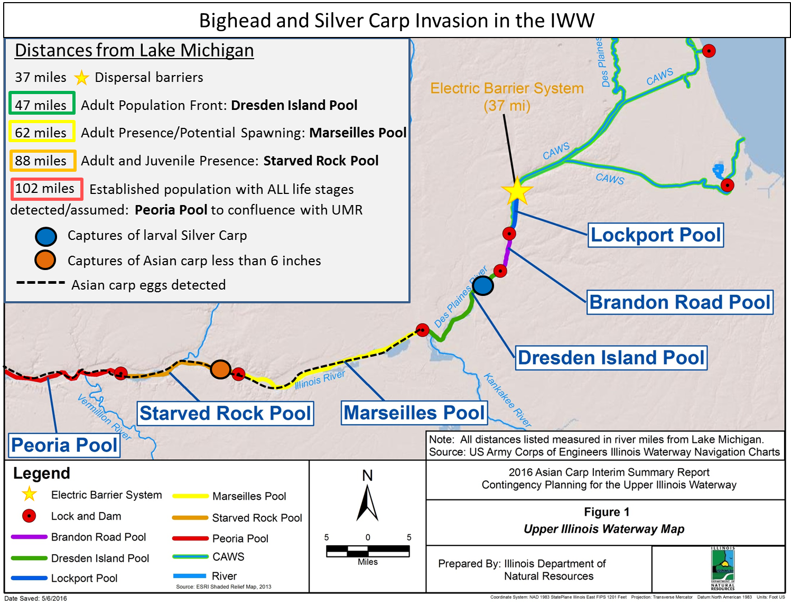
Bighead and Silver Carp Status in the IWW
Notes:
Unique to 2016, we are not catching the smaller sized Asian Carp (6 inches or less) that we saw last year
We will be updating this map using input from the ACRCC Listening session last month, at the MRWG meting scheduled for late Jan

Slide 17
USFWS 2017 Monitoring Activities
Environmental DNA (eDNA) | Genetic surveillance above the barrier in CAWS and below barrier in Lockport and Brandon Road pools; Black Carp Genetic Analysis; Genomic Mapping of Bighead and Grass Carp to Aid in Genetic Surveillance and Potential Genetic Control Efforts
Adult Asian Carp Monitoring | Great Lakes Asian Carp Monitoring Program; Monitoring and Response Team Support; Hydro-Acoustic Assessment of Lock Mediated Fish Passage in the Upper Illinois River; Analysis of Grass Carp in the CAWS; Black Carp Assessment: CAWS and UMRB; Barrier Defense Using Novel Gear
Juvenile Asian Carp Monitoring | Mass Removal and Monitoring of Juvenile Asian Carp; Barrier Defense Using Novel Gear
Barge-influenced movement of fish | Barge Entrainment and Interaction Studies; Predictive Model for Identifying Probability/Risk of Barges Entraining Asian carp
Support for USGS Technology Refinement | Registration of Microparticle Technologies; Registration of Carbon Dioxide Technologies
Outreach | Asian Carp Strategic Communications Plan and Website Operation and Maintenance

Slide 18
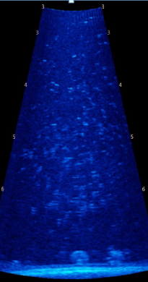
2016 USFWS Barge Studies
Downstream transiting barges resulted in reverse flow coupled with electrical sagging, allowing upstream passage of small, non-Asian carp species over the Electric Dispersal Barrier
Recognition of potential vulnerability does not represent an increase in probability/risk of Asian carp passage
Small Asian carp (< 6”) remain ~ 40 miles/3 lock and dam structures downstream from barrier
Enhanced Contingency Planning (added in 2016) = increased early detection/rapid response capacity (Monitoring and Response Work Group)
Underwater sonic view of fish moving upstream over barrier with a downstream passing tow
Notes:
These results were Results released Dec 2016
Results of other 2016 barge studies forthcoming early this year

Slide 19
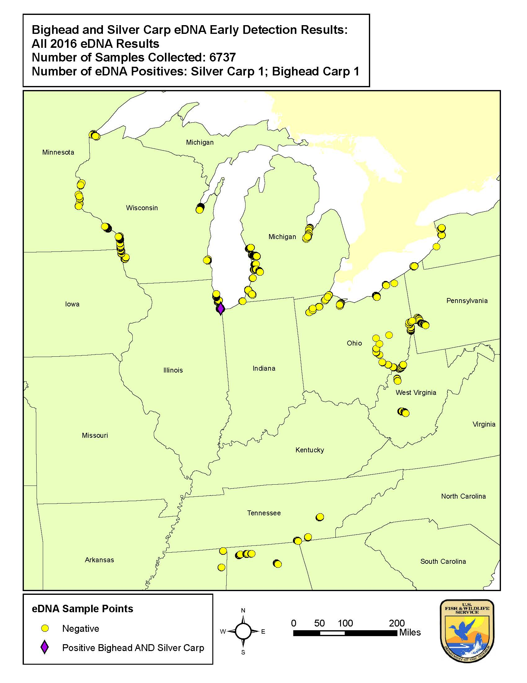
eDNA in 2016:
7,500 eDNA samples collected and processed for Bighead and Silver Carp in the Midwest
4,891 in Great Lakes region
ONLY ONE sample was positive for BOTH Bighead and Silver Carp eDNA (in CAWS)
eDNA surveillance work will continue in 2017
USFWS validating Black Carp marker for field detection
USFWS developing Grass Carp marker
eDNA handheld units will also be used in 2017

Slide 20
Asian Carp Population Reduction Efforts/Contingency Planning:
Leaving Nothing to Chance
Kevin Irons, Illinois Department of Natural Resources

Slide 21
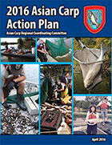
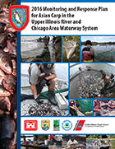
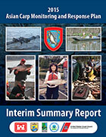
Asian Carp Monitoring, Management, and Contingency Actions
Coordinated Communication Strategy on results, findings and strategy

Slide 22
Actions to Date have Made a Difference
Vigilance
GOALS
Followed by Action
Over 5 million pounds of adult Asian carp removed
Understanding and use of deterrence continues to be improved
Harvest and monitoring informing on strategies for harvest and best management practices (entrainment)
Contingency Plan developed for unforeseen changes in Asian carp locations and dynamics (Pool specific, immediate and escalating coordinated responses)

Slide 23
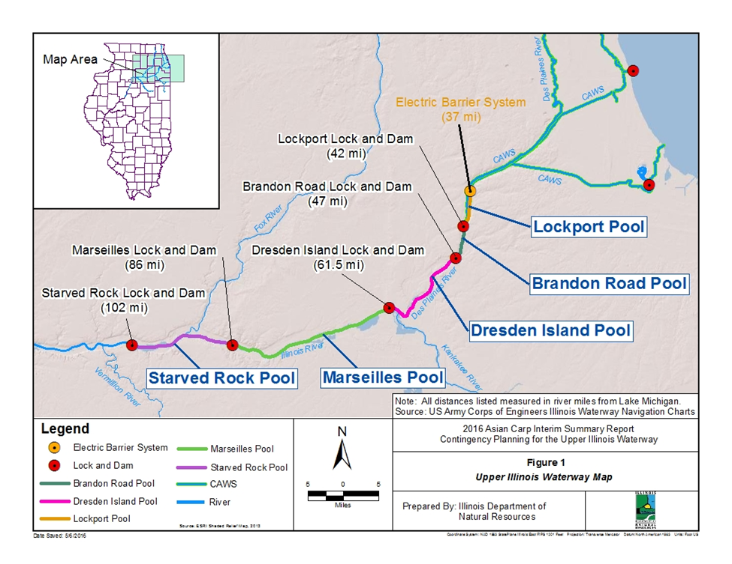
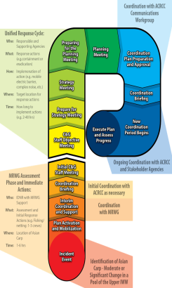
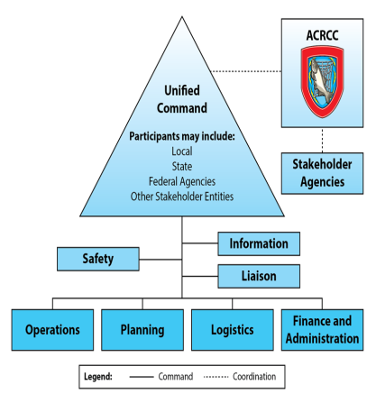
Contingency Planning for the Upper Illinois Waterway
Contingency Plan
In addition to robust monitoring and response plan
Pool specific
Definitions
Tools
Process
Preparedness
Authorities

Slide 24
Monitoring and Response Work Group Status
NO Bighead or Silver Carp observed or captured above Brandon Road Lock and Dam (14 miles below barrier)
Two seasonal intensive events in Chicago canals
No larval Asian carp captured in upper river (above Starved Rock)
No small Asian carp (under 6 inches) captured in any pool except Peoria (downstream of Starved Rock Lock and Dam)
Reduced population at upstream reach of Asian carp population
Extensive effort and gears used to monitor for small Asian carp
eDNA genetic surveillance continues above barriers

Slide 25
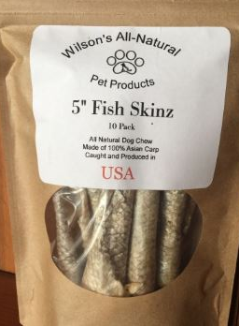
Additional Activities
Barrier maintenance suppression:
Concentrated efforts around barrier during planned maintenance or unplanned outages
Unified Method:
Successful collaboration with Chinese scientists and fishers in March 2016, will repeat in 2017
Continued dialogue with industry to use market pressure to assist in fight
Asian carp harvested go to use for local vendors in products such as dog treats

Slide 26
Asian Carp Technologies Update
Mark Gaikowski
Director,
USGS Upper Midwest Environmental Sciences Center

Slide 27
Control Tool Status
Life History
Ecosystem Impacts
Detection Tools
Control Tools
IPM
Carbon Dioxide (CO₂) as a Deterrent/Barrier
CO₂ is an effective deterrent in lab/pond studies-Bighead and Silver Carp avoid CO₂
Identify effective concentrations and affects of temperature, compared injection system
Multi-agency Advisory Group formed; transitioning tool to implementation
Underwater Sound as Asian Carp Deterrent
Bighead and silver carp avoid broadband sounds; native fish little response
Preliminary results indicate effective for “herding” and may increase capture of fish
Assessing potential habituation to repeated exposure, optimal frequencies
Microparticles Targeting Bighead Carp and Silver Carp
Developed lethal & non-lethal formulations, developing production capacity
Completed pond tests to demonstrate bigheaded carps ingest toxic microparticles
Completed non-lethal targeted microparticle field application, results pending

Slide 28
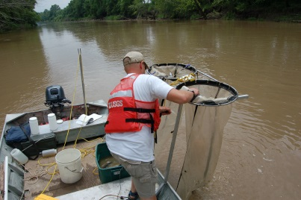
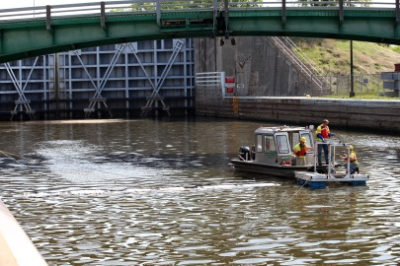
2017 Actions
Hydraulic and WQ data supporting partner efforts
CO₂ as a deterrent
Underwater sound
Algae used to attract Asian carp and enhance microparticle delivery
Acoustic telemetry database
Toxic microparticles
Microparticle and CO₂ registration
Hot water/ozone/chlorine lock treatment testing
Early detection molecular technologies
Early detection eDNA: Hand held rapid detection tool
Grass Carp detection/control
FluEgg Simulation Model
Black carp – life history, toxic bait development
Integrated Pest Management
Brandon Road Lock and Dam hydrologic support

Slide 29
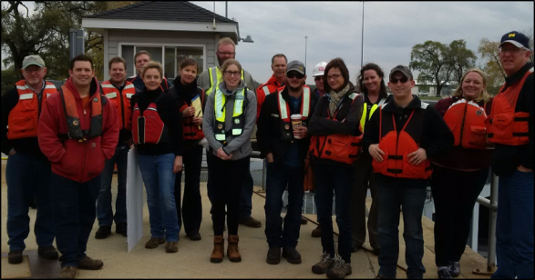
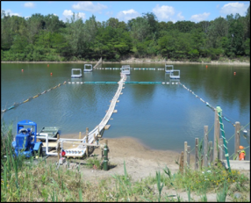
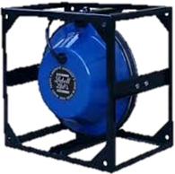
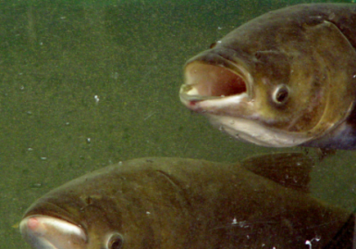
2017 Actions
Carbon Dioxide – Conduct field studies for management applications
Block Asian carp access to backwaters; enhance removal efforts
With USACE, identify and characterize large-scale field sites to evaluate feasibility of CO₂ injection
Underwater Sound – Field Implementation
With USACE, plan and implement a deployment (7 days) at Brandon Road Lock
Conduct trials to deter Asian carp from drainage canals (Emiquon NWR)
Microparticles – Field Trials
Assess impacts on non-target species with surrogate non-lethal microparticles
Assess environmental fate of lethal microparticles

Slide 30
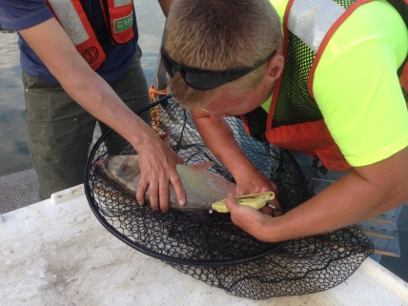
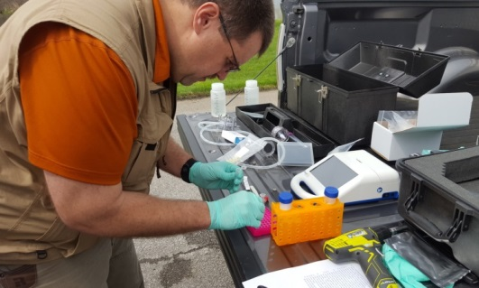
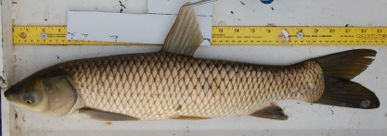
2017 Actions
Grass Carp
Refine likely spawning and hatching locations on Sandusky River (Ohio)
Map aquatic vegetation in Lake Erie to inform management actions
Fish Telemetry Network/Database – Multi-agency/universities
Release initial visualization tools on Asian carp movement for general use by partner agencies to aid with management actions.
Implement automatic early warning system to notify key partners via text and email of notable movements by Asian carp
Hand Held eDNA Asian Carp Detector
Testing use to detect Asian carp in bait shops with Ohio DNR, Michigan DNR, and Illinois DNR.
Responding to state agency requests to extend to open water application

Slide 31
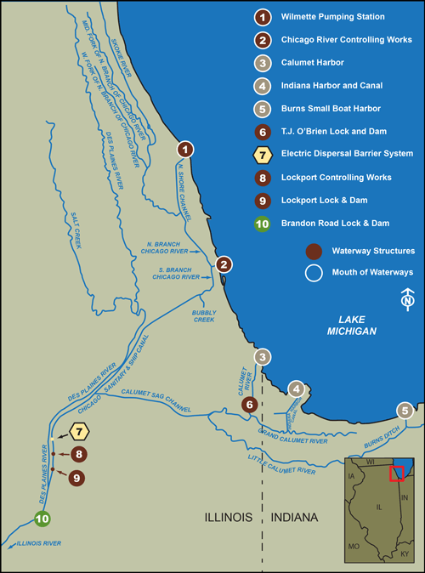
USACE 2017 Actions
COL Christopher T. Drew
Commander, Chicago District
11 January 2017
US Army Corps of Engineers
BUILDING STRONG®

Slide 32
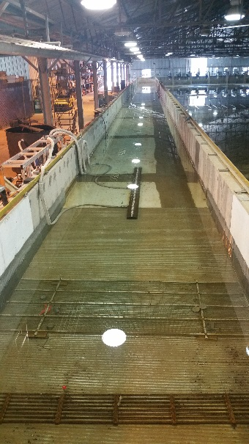
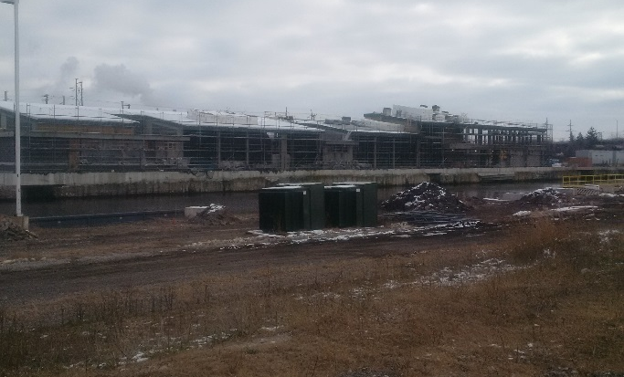
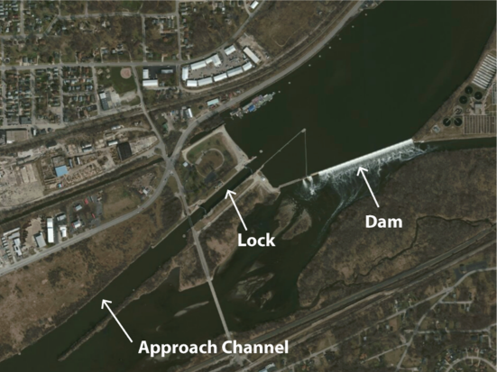
Key 2017 USACE Projects
Pathway Closures and Control Measures
Construction and Operation of Electric Barriers in the CSSC
Execution of the Great Lakes and Mississippi River Interbasin Study (GLMRIS)
Brandon Road Study
Technical Support to Ohio for the closure of the Ohio-Erie Canal pathway
Development and Testing of Measures to Address Barge Entrainment
Field Demonstration of Sound Deterrent with USGS
Detection, Monitoring and Control
Support to the Monitoring and Response Workgroup
Construction of Barrier I
Brandon Rd L&D
ERDC Test Flume

Slide 33
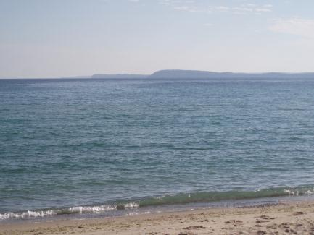
For more information
Please visit www.asiancarp.us

